Slide 1
HomebrewJS Talk
by Dave Campbell
dave@sedillocanyon.net
Github: CanyonCasa

Slide 2
Scope
About Me
Define and describe HomebrewJS…
Hardware/Software overview
Background…
NodeJS Ecosystem
SQLIte Database Wrapper
VueJS Components (client)
HomebrewJS Breakdown
Server Scripts
Configuration
Example Applications
Shopping Network
Server Monitor

Slide 3
Bio – Dave Campbell
Born/raised in Danville PA.
Inspiring home of Joseph Priestly, Thomas Beaver, Christopher Sholes, Geisinger Medical Center, …
Associates of Electrical Engineering Technology from Ohio (DeVry) Institute of Technology, Columbus OH.
Formally trained in IBM 1130 mainframe Fortran 77 and assembler.
Self taught over 2 dozen languages, including Intel, Motorola, & RCA assemblers, BASIC, C, C++, Java, Pascal, RATFOR, Visual Basic, scripting languages AWK, Batch, Bash, Perl, Python, and Sed, web languages CSS, HTML, JavaScript, SQL, and XML, as well as specialized engineering languages like LabVIEW, Mathcad, SPICE, and it goes on…
Written a few languages from scratch for specialized applications too!
Retired from SNL as Distinguished Member of Technical Staff after 37 years.
Have Operated web sites for personal and non-profit use ~ 25 years.

Slide 4
Origins
While at school (late 70’s), Columbus Homebrew Computer Society introduced me to the world of personal computers and nurtured a DIY environment of experimentation and dreaming.
My first (true) PC…
IBM PC Model 2, 4.77MHz, 64KB, RAM, 5-1/4” floppy, no HD (1982), with monochrome (green) monitor. Cost: $2,300. ------ a fraction of the power of the $35 Raspberry Pi!!!!
1993 National Center for Supercomputing Applications (NCSA) introduced Mosiac, the first graphical web browser, released into the public domain.
I began developing web sites in 1993 using HTML 1!
Internet technology has evolved greatly since that time, not always for the better.
December 1995 Netscape introduced JavaScript as part of Navigator 2.0.
I mention these things because…
To learn more of the history of the Internet from its origins in the MIT Model Railroad Club, till today, I recommend reading Walter Isaacson’s, The Innovators: How a group of hackers, geniuses, and geeks created the digital revolution.

Slide 5
What is HomebrewJS?
Description of HomebrewJS project and motivations

Slide 6
The HomebrewJS Server
Represents a DIY highly-flexible and easily configured web server based on NodeJS for small demand applications with low resources.
Intended for my personal IoT use, but robust enough for small business use.
Features…
100% JavaScript based on NodeJS.
100% free! – source & documentation on Github @CanyonCasa
Configured with a JS or JSON file – no code development needed for many apps.
Minimal server toolchain and resources – easily runs on a Raspberry Pi!
NodeJS and modules
SQLite database
Able to serve all kinds of content, including websockets*.
Full support of HTTPS with Let’s Encrypt.
Reverse proxy to enable multiple domains (1~10) from single IP address.
Non-superuser operation for better security.

Slide 7
The Ecosystem

Slide 8
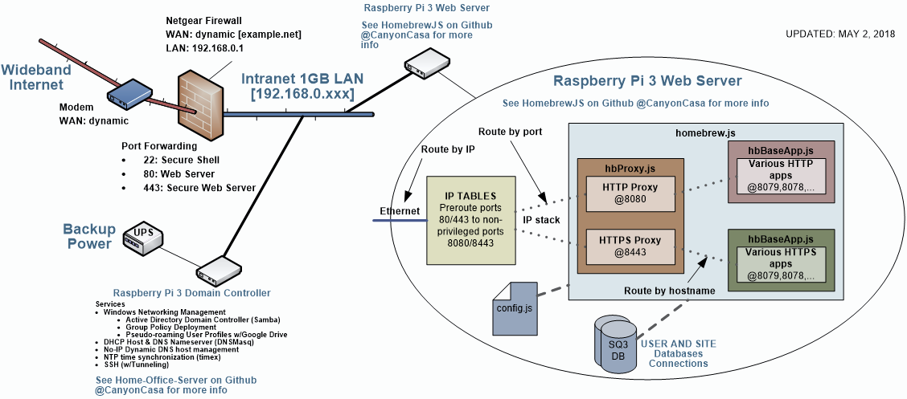
Key Points…
2. Router forwards web requests
4. Reverse Proxy forwards request to each port based on hostname
Requests sent to WAN IP based on DNS lookup
3. IP Tables route requests to non-privileged ports
5. Dedicated apps implement singular services
1. No-IP DUC syncs WAN IP with domain name

Slide 9
Background
Tools and services details

Slide 10
Out of Scope
No-IP dynamic hosting service (https:www.noip.com).
Router port forwarding.
Domain controller server.
DHCP, DNS, NTP, …
IP tables setup.
For more information see Home-Office-Server documentation on Github @CanyonCasa.

Slide 11
NodeJS
A server side JS engine for writing your own web services.
Based on Google’s V8 engine.
Bears out the saying ‘mother is the necessity of invention.’
Google recognized its dependency on JavaScript and the crippling performance of the traditional JavaScript engine. Their rewrite went from 10x slower than the render engine to 10x faster!
Obvious, conclusion. Why not apply it to the server side to simply code development?
Single threaded, fully asynchronous operation (i.e. event driven).
Responsive, fast, and efficient, using miniscule resources compared to other servers.
Modular design offers separate namespaces and enables packaging code in small well understood blocks.
Vibrant developer community with large collection of support libraries.
Realistic web applications more sophisticated than the simplistic Node examples, thus the birth of HomebrewJS.

Slide 12
SQLite3 Databases
Simplest of databases.
Single file – move where you like.
No server to mess with or mess with you.
No login necessary for access from NodeJS.
Async bindings for NodeJS.
Capacity greater than anything you’ll ever need.
Easy migration from MySQL, …
Shell commandline SQL tool.
Open source GUI interface (DB Browser for SQLite).
WrapSQ3 provides a set of high-level functions for powerful REST use.
15+ years of experience.

Slide 13
VueJS (Client side)
Kinda out of scope, but worth a mention a since it drives the modus operandi regarding some server decisions.
VueJs is a client side templating framework, similar to Angular.
Simpler, like Angular 1 and 2.
Depends on a server side database REST interface.
Does not require a packaging build step (i.e. Webpack, Browserfy, …).

Slide 14
HomeBrewJS Source
Breakdown of the server scripts

Slide 15
The Homebrew Scripts
homebrew.js: Glue script that loads configuration, launches app servers, and starts proxies.
hbInternals.js: Server that provides communication to the internals of the homebrew server.
hbProxy.js: Reverse proxy server.
hbBaseApp.js: A baseline Express application suitable for a large majority of applications and web sites, or to serve as a template for a custom app.
hbAuth.js: All in one authentication and authorization support optionally loaded by hbBaseApp.js to interface site to user database.
Modules: A number of modules that support basic web services.

Slide 16
NodeJS Modules
bcryptjs: Bcrypt algorithm routines. (Used to encrypt users credentials, hbAuth.js)
colors: Support for colored transcripting. (Scribe,js)
Express: Express 4 Framework. (hbBaseApp.js)
body-parser: Express JSON support.
compression: HTTP compression support.
cookie-parser: HTTP cookie support. (Supported but not needed by Homebrew)
express-fileupload: File upload support.
express-static: Integrated Express support for serving static pages.
multer: Multipart form decoding support.
emailjs: email service. (Notification.js)
http-proxy: Reverse proxy server. (hbProxy.js)
promise: Promises support. (Integrated into NodeJS)
sanitize-html: Filtering for HTML input. (SafeJSON.js)
Sqlite3: SQLite3 database bindings. (WrapSQ3.js)

Slide 17
Custom Homebrew Modules
Extensions2JS.js: Personal JavaScript language enhancements.
Scribe.js: Logger for homebrew server and middleware.
WrapSQ3.js: SQLite3 database wrapper to abstract database interface.
SafeJSON.js: Library of JSON filtering functions, including HTML strings.
csv.js: Comma Separated Value format parsing functions.
Notification.js: A module for sending SMS (email gateway) and email messages from server.
Cleanup.js: Provides hooks for graceful shutdown of server.
CryptoPlus.js: Embellishments to crypto library to simplify common and frequently used tasks.

Slide 18
The Homebrew Middleware
data.js: Implements a database and file REST interface based on predefined “recipes” stored in database definitions table. (Required)
utility.js: Implements a number of server diagnostics and info interfaces for debug and development use. (Optional)
mapURL.js: Module to redirect and rewrite web requests. (Optional)
templates.js: Module to dynamically process Pug, MD, and DHTML templates. (Largely considered obsolete with use of client side VueJS templates.)

Slide 19
Homebrew Configuration
Configured using a JavaScript or JSON file.
JavaScript file enables use of comments, imports, and any other JS construct, but does not need to be complicated code.
Many parameters configured to simply pass through to underlying modules.
Sensitive or private data placed in separate file for security maintenance.
For secure operation, never place configuration or database files under web root.

Slide 20
Homebrew Project Setup
Dedicated non-privileged user: js.
All files placed in /home/js
Assumes default structure to the left, but defined by config.js
cd to /home/js/bin to install node_modules
~/bin $npm install --save module
Note: Run npm -init first!
Start…
~/bin $node homebrew
Recommend tmux setup.
See Home-Office-Server at Github.
/home/js
bin: Contains JS code
node_modules
logs: folder for log files.
restricted: Location of config.js and databases.
sites: folder for sites…
a: site a files.
b: site b files.
…

Slide 21
HomeBrewJS Sites
Example applications

Slide 22
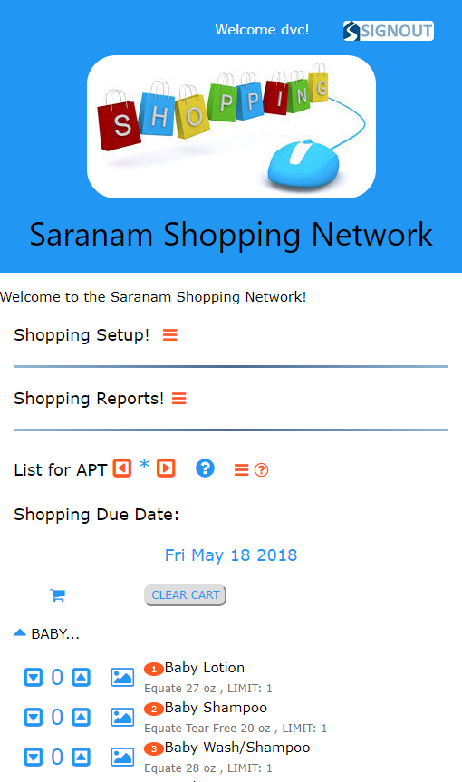
Saranam Shopping Network
Saranam is a non-profit housing, education, and community building program.
Each month the Family Services and Volunteer Coordinator “shops” for baby and personal items for the enrolled families.
The app allows families to shop online to request needed items, similar to other online shopping services.
It aggregates all these “client orders”, as well as inventory, into shopping lists by vendor for the volunteer shoppers.
It also, creates distribution lists and tracks costs.

Slide 23
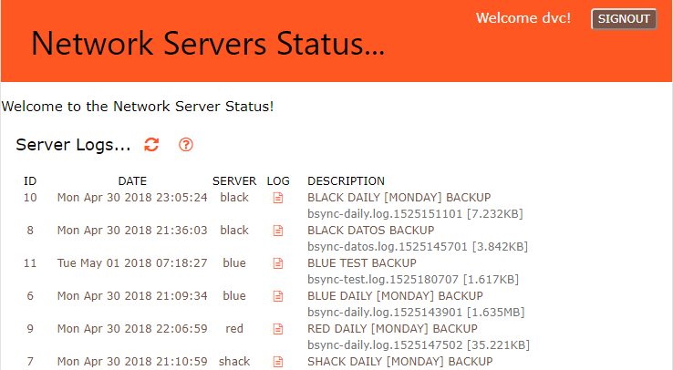
Server Monitoring
Logs server activities for online monitoring of server state of health.
Logs posted from backup scripts, etc using curl.
Provides log dump on demand.

Slide 24
Node-Red Proxy

Slide 25
Any new technology tends to go through a 25-year adoption cycle.
– Marc Andreessen, founder of Netscape
Q&A Discussion

Slide 26
WWW and Browser Evolution
1989: Tim Berners-Lee proposed an Internet hypertext system
1991: “HTML Tags” first public disclosure, defined 18 elements
1993: Internet Engineering Task Force (IETF) publication of HTML spec.
1993: Mosaic – Granddaddy of the graphical browsers
1994: Mozilla (i.e. Mosaic killer) → Netscape Navigator (Marc Andreessen)
Captured 75% of market in 4 months!
1995: HTML 2.0 specification published
1995: Navigator 2 with JavaScript
Brendan Eich wrote the prototype JavaScript in 10 days!
Netscape’s $2B IPO ignited the dotcom bubble.
1997 HTML 3.2 published

Slide 27
More WWW and Browser Evolution
1995: Microsoft introduces Internet Explorer
Marc Andreesen said, ‘Microsoft could never catch up with Netscape.’
By 2000 MS IE held 95% of the browser market.
1997: HTML 4.0 specification published
1998: Mozilla Project → Firefox
2000 : HTML 4.01 specification
2000: XHTML 1.0 published
2004: HTML 5 specification began
2008: HTML 5 specification delivered to working group
2008: Chromium Project → Google Chrome
2014: HTML 5 specification standardized.

